Slide 1
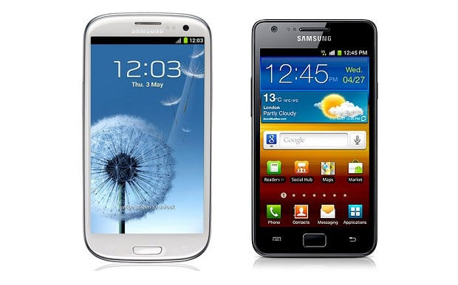
SMART LIVING WITH SMARTPHONES
Partnering with a Smart Phone for a Smarter Life Boost
Gigi Johnson, EdD
https://maremel.com/smart-smartphones
This Photo by Unknown Author is licensed under CC BY-SA

Slide 2
What do you want to learn today?

Slide 3
Do you have an Android or iPhone?

Slide 4
What are your 2 biggest regular life challenges (besides your phone)?

Slide 5
Superpowers and challenges
Extend your abilities
Extend your memory
Information at your fingertips
Connect with others – window on other places
Selling you Ideas and Products
Limiting your Choices
Tracks your Actions
Costs and Problems with Service and Equipment
Challenges

Slide 6
Ways to use tools and connections
Me
Phone
Family and Friends
Text
Video calls
Share: Holidays/Celebrations, Photos
Friends of Friends
Share articles
Connect Globally
Deals for shopping, clothes, food, electronics – Price matching
Political information
Books, music, podcasts
Apps
Financial: bank, payments
Memory
Phone and addresses
Groups for News
Learn together – skills, crafts
Fandom – sports, art, music, food, recipes
Meet new people
Companies and Strangers
Maps and directions
Ride share
Search
Store files and photos in the cloud (also with friends and family)
Share photos

Slide 7
PERSONALIZATION
Personalized by THEM
Defaults
Pushes
Personalized by YOU to think like you do
Get beyond the Defaults
Positive tools vs. pings and next screens
Time, memory, backup, sleep, health
Connected to control your home
Personalized around your FRIENDS and FAMILY
Connect around the world
Share pictures, videos, and memories
Celebrate holidays and milestones
Notes:
– Alexa, Google Chromecast – push to your TV

Slide 8
What is a “Default”?

Slide 9
What is a “Nudge” or “Notification”?

Slide 10
What is “VoIP” and “Wi-fi”?
VOIP – Voice Over Internet Protocol – making a call over the wireless signal vs. a phone call
Wi-Fi – a wireless networking protocol that lets devices communicate without being connected by cable through a router to a connection to the Internet

Slide 11
Expenses/Costs
Phone and replacement cycle
Service – Seniors Deals
T-Mobile 55+ $50/mo 1, $70 for 2 (unlimited data)
“Unlimited” data vs limits/caps/throttles
Apps and tools – free/freemium/in-app
Consumer Cellular - $30 w/2 GB data
Sprint Unlimited 55+ - $50 for 1, $70/2

Slide 12
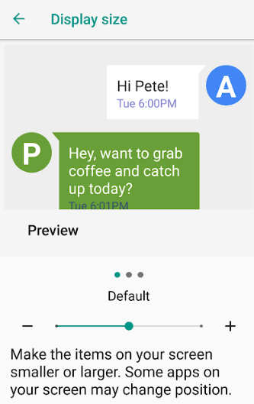
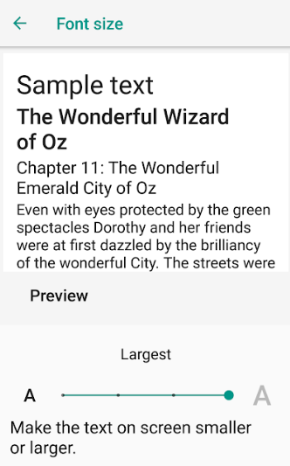
Basics and setup
Font size / Vision
Notifications
Screen Protection / Repair
Phone Lock – fingerprint, voice, face
Battery management; external batteries
Accounts

Slide 13
Privacy and Security
Passwords
Recovery Email
Two-factor authentication for financial
Wifi – not private

Slide 14
VOICE
Voicemail and messages
Who you give your number to
What’s with all the SPAM/PHISHING calls (and what is Phishing)?

Slide 15
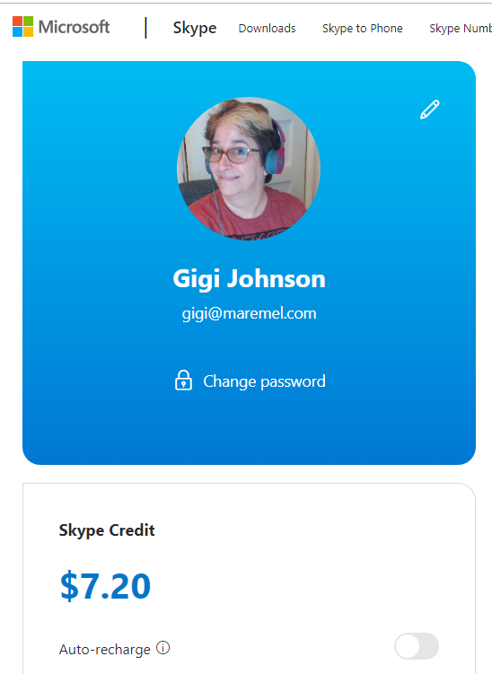




VIDEO CALLS
Skype**
Apple Facetime**
Google Hangout**
Whereby**
FB Video Calling & Live**
Zoom
GoToMeeting
    ** Free Versions

Slide 16

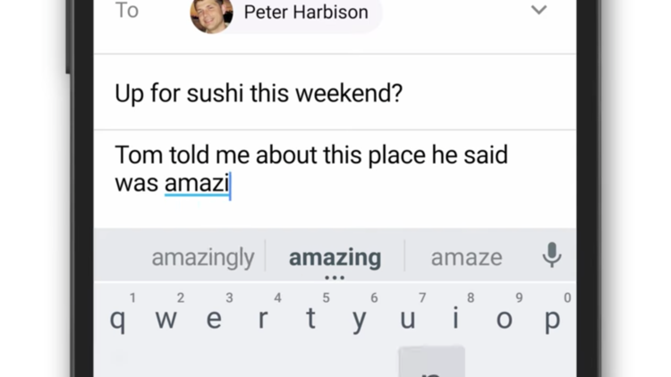
Email
2 addresses? “registering” – Friends and Family vs. services
Benefits and Challenges of Autocomplete

Slide 17

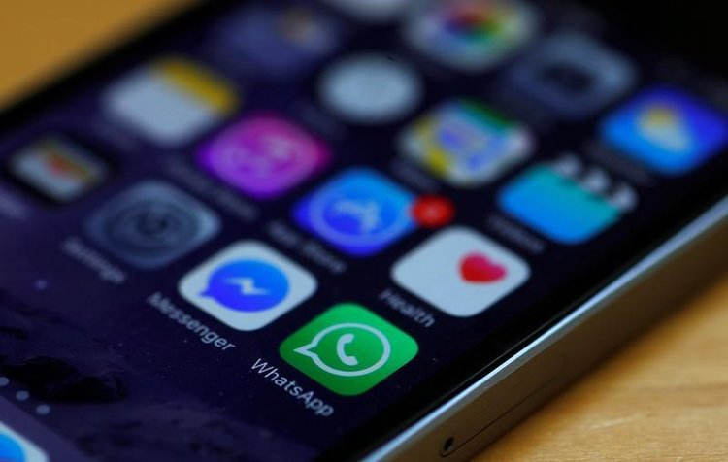
Texting
One to one
One to group (e.g. GroupMe)
SPAM increasing
Private?
WhatApp, Facebook Messenger
Instagram DM (direct message)

Slide 18
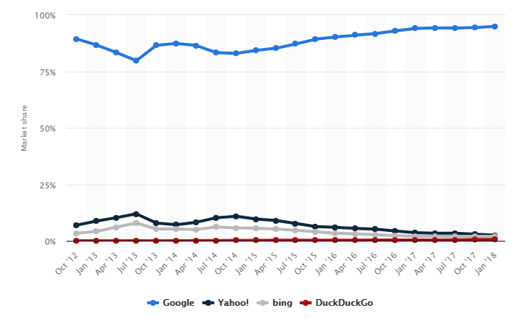
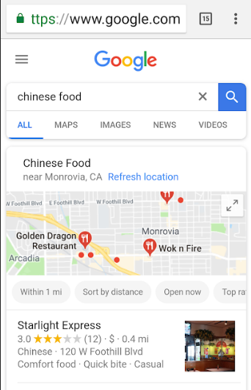

Search AND TRUSTED INFO
Keywords- and ad-driven
Can be voice controlled -- Alexa, Google Home, Siri
Google affects what you see on other sites, like YouTube
Review sites – paid for ad placements
Blogs – unique experts to follow plus other crap with w/o commercial
Affiliate Links – realizing that many sites make money off of % of recommendations – few are neutral
Consumer Reports: one solid source

Slide 19
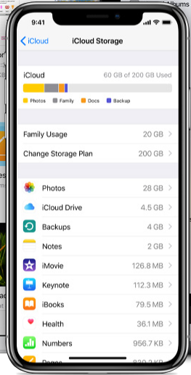




What is the “Cloud”?
The Cloud is a server somewhere else that makes a copy of content on your phone, tablet, or computer. It is a business model.
Can be Automatic Backup
Can permit access and editing from multiple devices or with multiple people (e.g. family)
Usually is “freemium” – some for free, then more for money

Slide 20
Smartphone Apps – Millions! But…
Average Person uses only 11-15
Business Models: “Free” / Freemium / In-App Purchases
Each has Defaults and Notification permissions

Slide 21
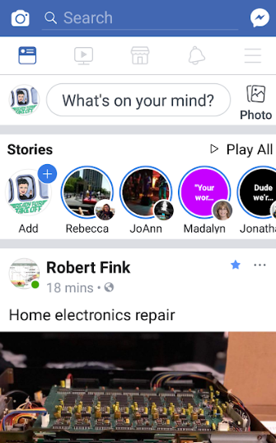
Facebook:
1.7 Billion people
Closed to whom you want…BUT
Say No to Polls and Unknown Friends
Set Privacy and Defaults
Hacking Growing
You see 1% of Pages and 30% of Friends’ Posts – Facebook decides for you
You are the Product – 100% targeted ad based

Slide 22
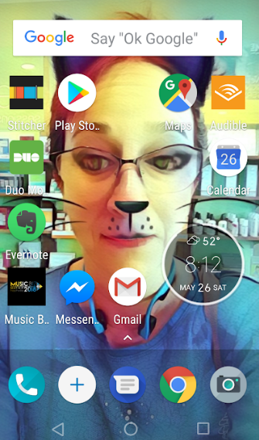

Photos and Sharing
Attachments – download from emails ONLY from people you know well
Editing tools
Photo Apps with image tools, including Facebook, Instagram, Snapchat

Slide 23
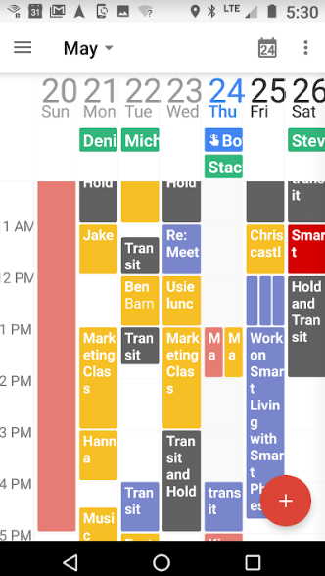
Memory/Recall
Calendars and alarms
Photos as memory
Pictures of where you park your car
Apps – Trello, Toodledo, Google ToDo, Amazon Alexa To Do
Set reminders for bills, pills, exercise, sleep, water lawn

Slide 24

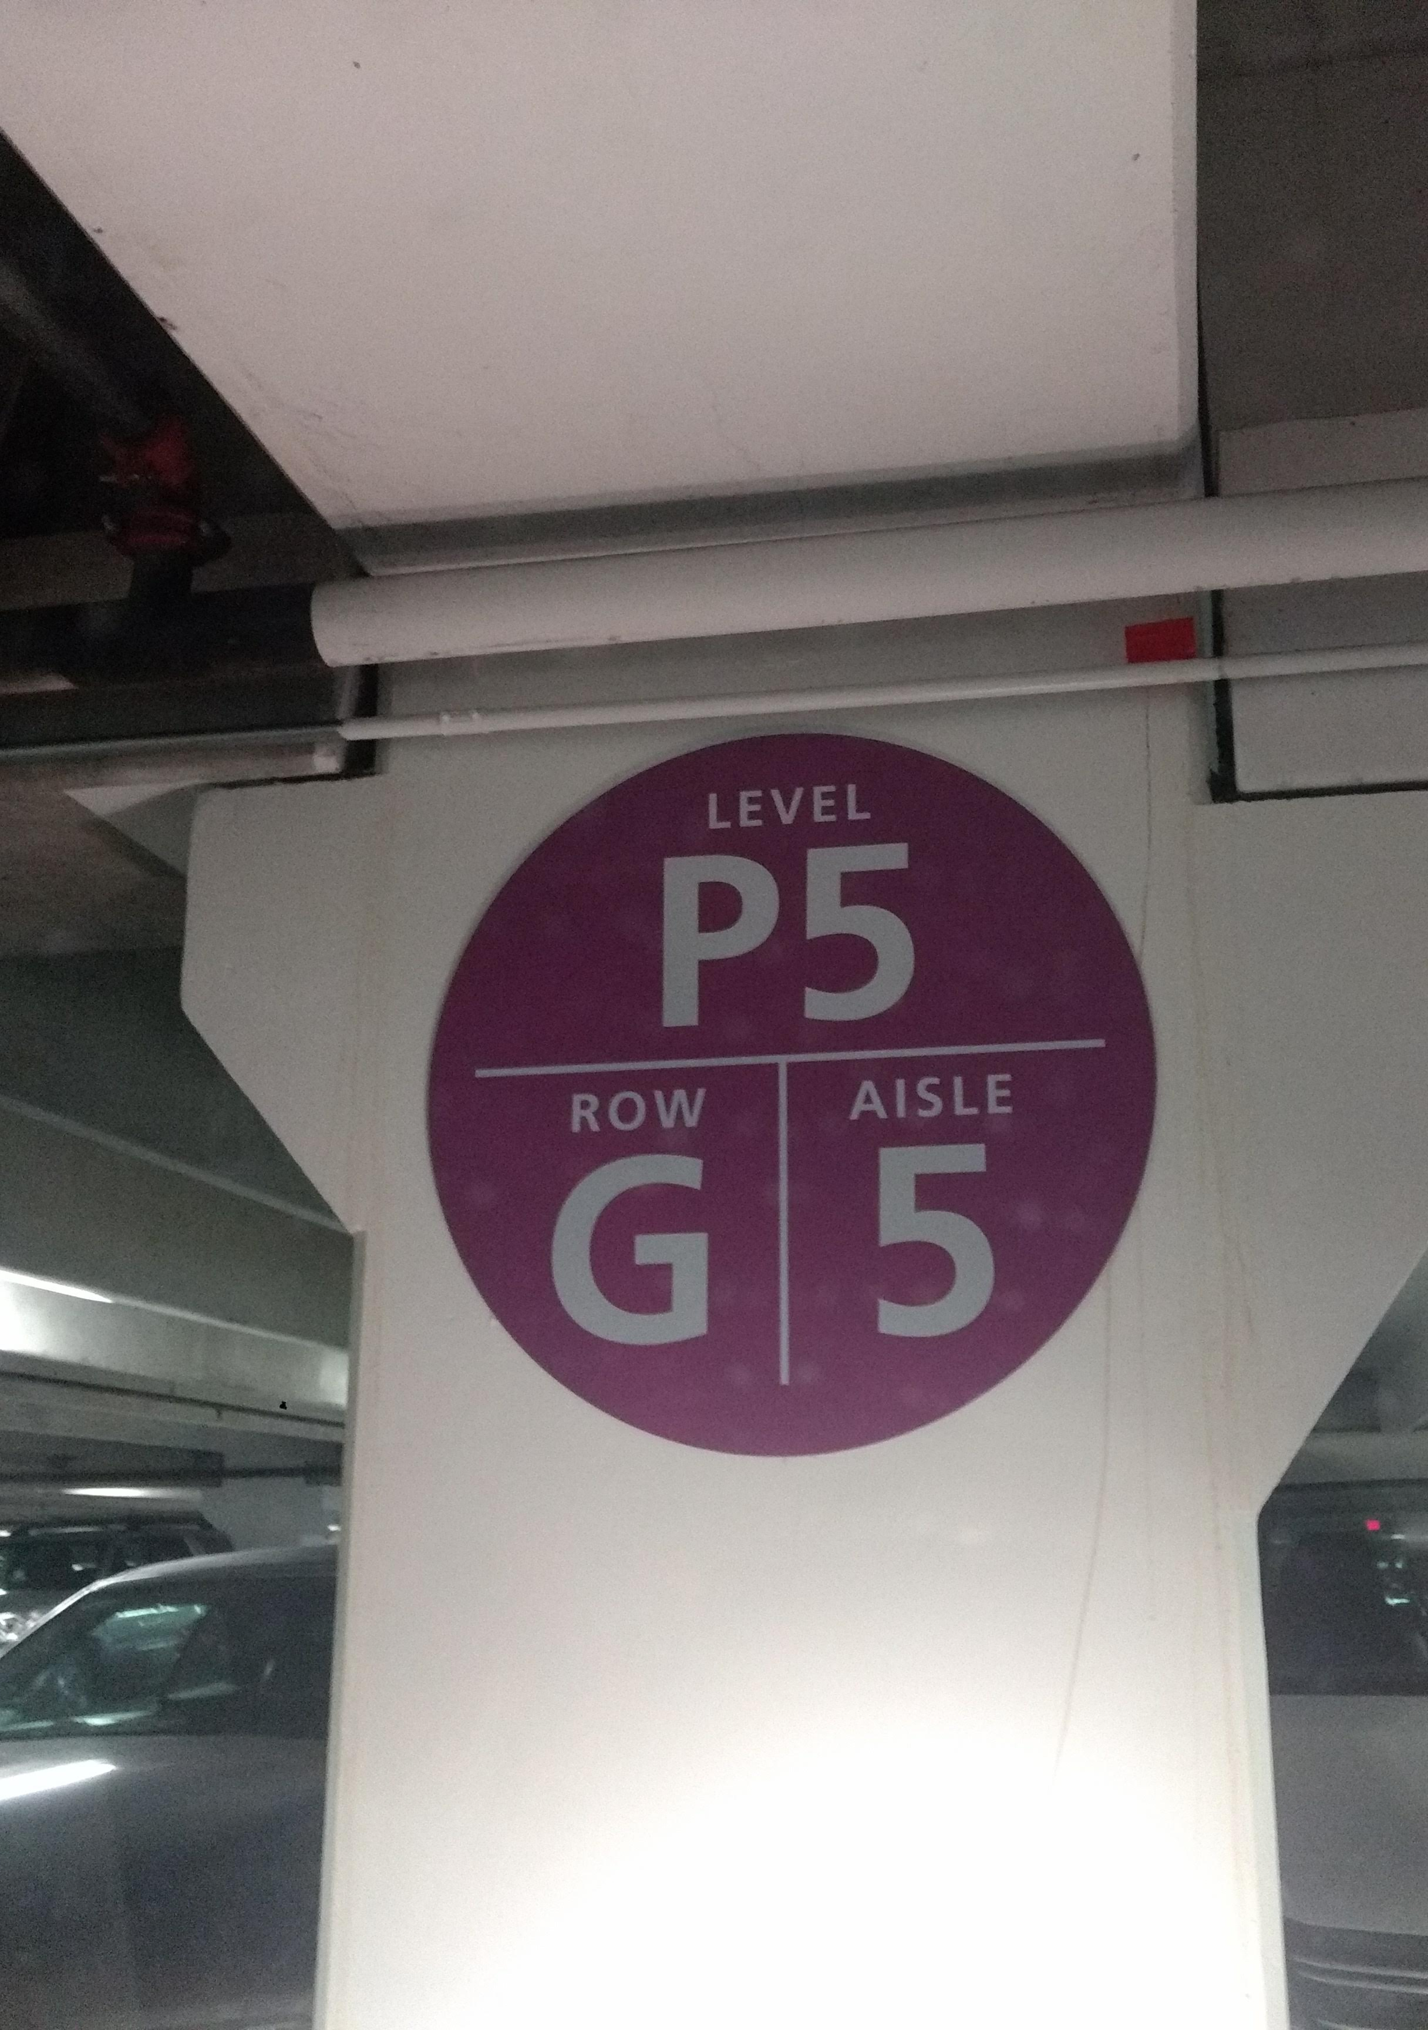
Photos as memory

Slide 25
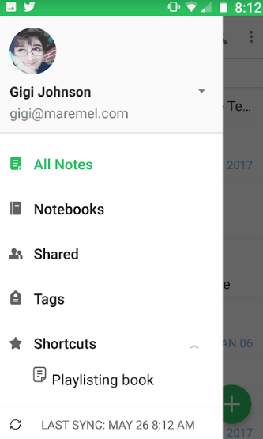
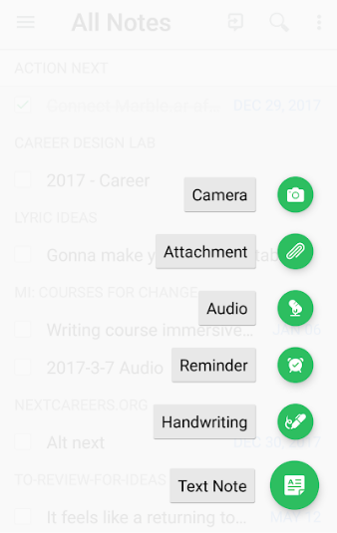
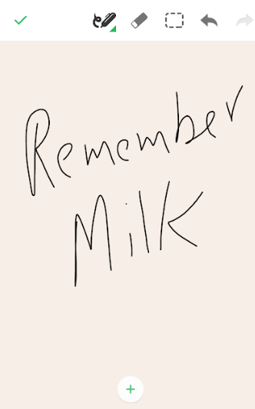
Evernote: 100 year memory

Slide 26

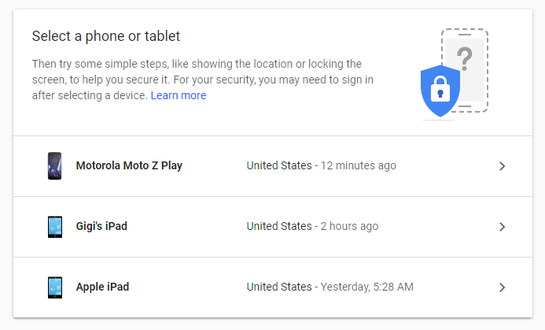
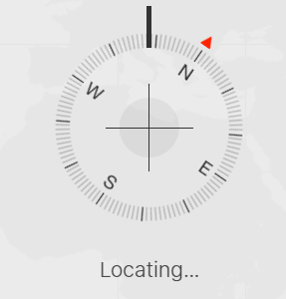


Find My phone . . . Or car . . . Or keys

Slide 27
PAYMENTS – pay from your phone
Apple Pay
Android Pay
PayPal
Square
Fast Food Apps (pre-order)
Venmo (to friends)

Slide 28
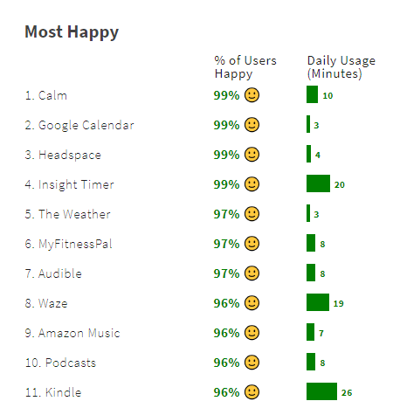


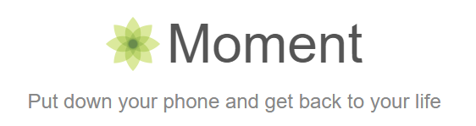

Emotional Health

Slide 29
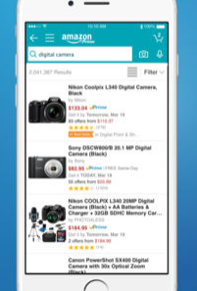
Online and live Shopping
Amazon Share
56% online, 5% total
Purchasing Search – 50+% starts on Amazon
Abandoning Shopping Carts
60-80%
New Trend – Pick Up or Return at Live Store
Old Trend – Price checking

Slide 30
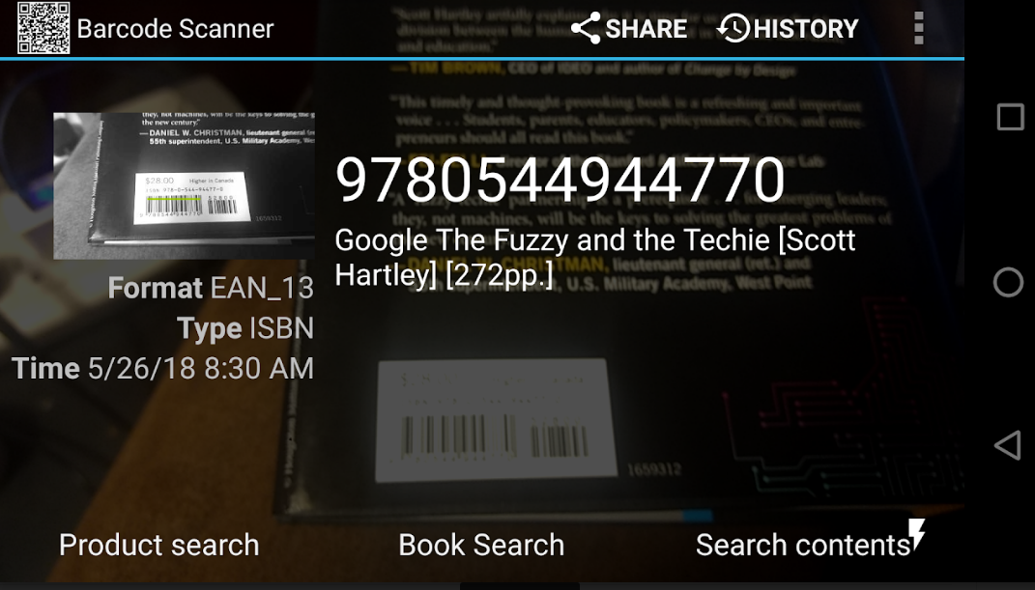

Slide 31
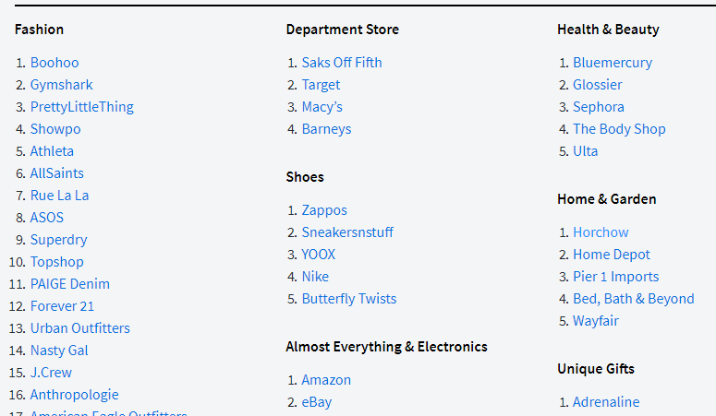
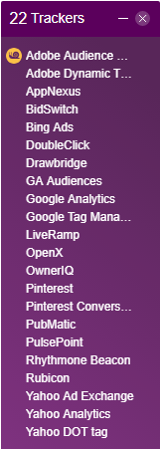
LOTS OF LINK-FED retail
Retargeting – ad will follow you after looking at items
Pixels – code on website to track your visits across sites
Affiliate Deals – Links to pay for your attention in review blogs and sites

Slide 32
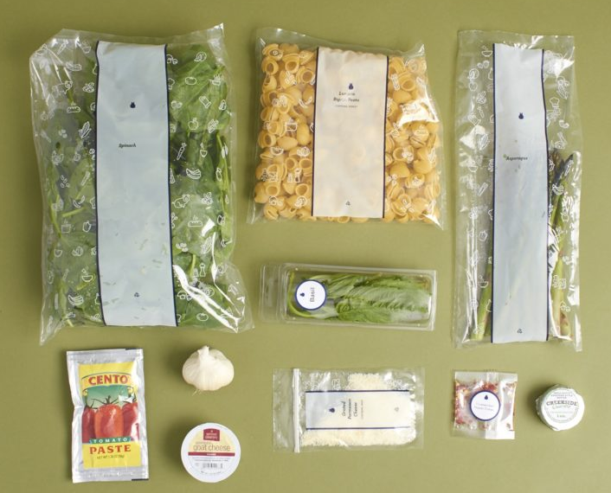



Food to Cook
Amazon Fresh / Whole Foods
Grocery – Vons.com – deliver to the home / kitchen
Meal Kits and Box Subscriptions services – brings whole meals to you

Slide 33
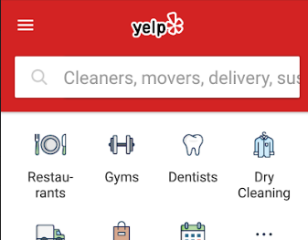
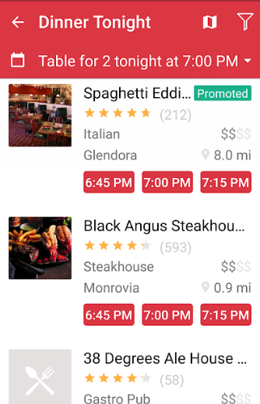
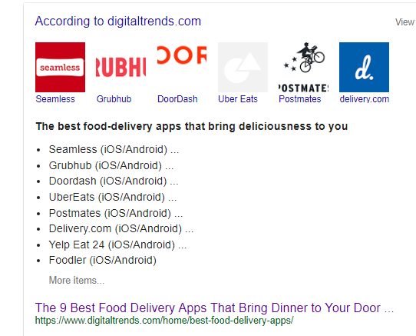
Restaurants: choice and delivery
Picking – Yelp, Open Table (reservations and reviews)
Others can bring food to your door
Grubhub
Doordash
UberEats
Postmates
Yelp Eat

Slide 34

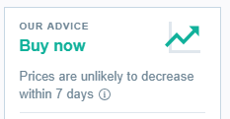


Travel
Choice –Kayak – timer for best pricing
Tracking – Tripit – tracks all moving parts of a trip, including weather
Travel Blogs – often Affiliate deals, but insider offers
Credit Cards – deals for travel

Slide 35



Events
Eventbrite
Meetup.com

Slide 36




Books
Amazon
Kindle
Overdrive with public library
Email PDFs to Apple or Google Books

Slide 37


Slide 38


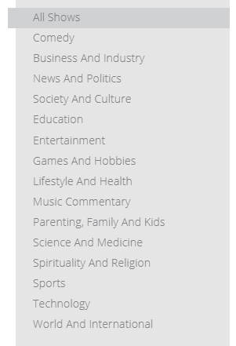


Podcasts
FREE -- Stitcher, Spotify, Google, TuneIn, Apple Podcasts

Slide 39
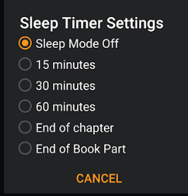
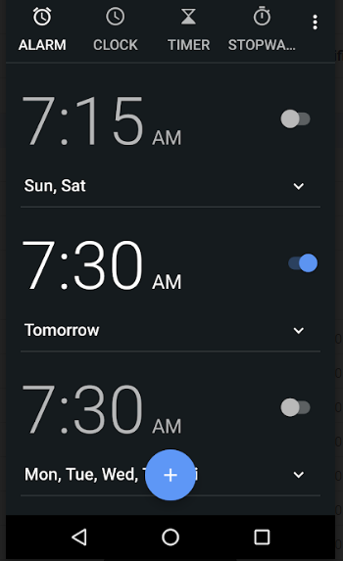

Sleep
Sleep timers on most apps
Audio books or podcasts to sleep or when you can’t sleep
Sleep music playlists on Spotify

Slide 40





Video
Watch Everywhere
Wifi!

Slide 41





Music
Free: YouTube, Pandora, iHeartRadio, Spotify Free, Amazon Music (partial)
Playlists for sleep, exercise

Slide 42
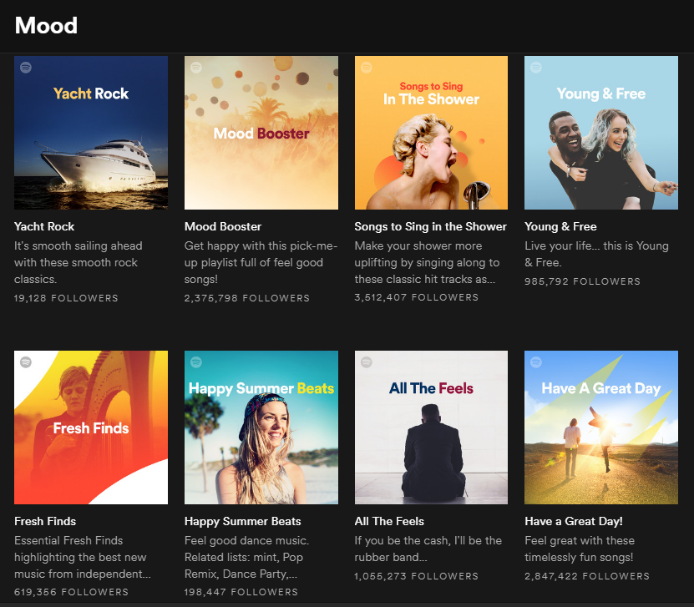

Playlisting our moods
Spotify for Brands –
Selling our emotional state with music and behavior

Slide 43




Learning

Slide 44




Subscription learning

Slide 45
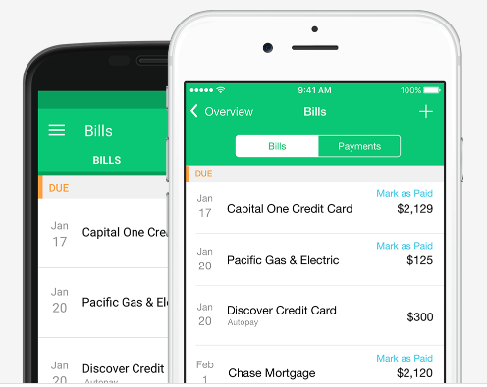
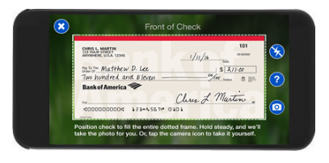
Banking/Finance
Your bank app – photos to deposit checks
Mint – tracking your expenses automatically
Passwords that are VERY secure

Slide 46

Games
Casual Games
Games with Family at a Distance
Social – Words with Friends
Careful of in-app purchases to “level up”

Slide 47

Smartphone + Related equipment
Alexa / Google Home / Smart Speakers
Control of heater, door, blinds, etc.
“Wake word” – listening
Instant connection with other Alexas or Homes
Google Chromecast or Amazon Fire TV
Voice control of TV
No need for cable other than sports

Slide 48
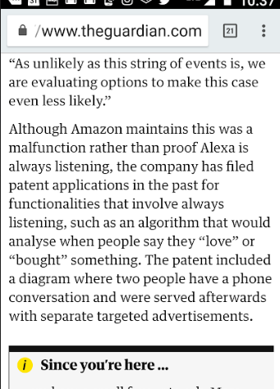
Are they
Listening?

Slide 49
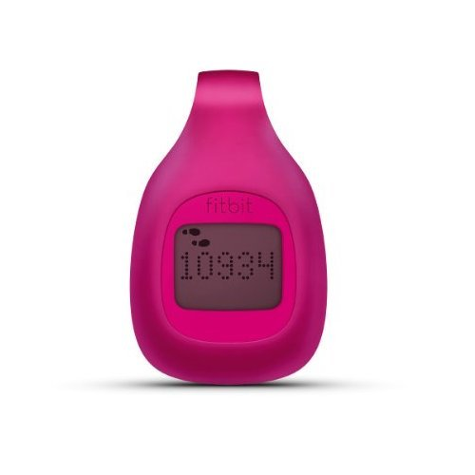
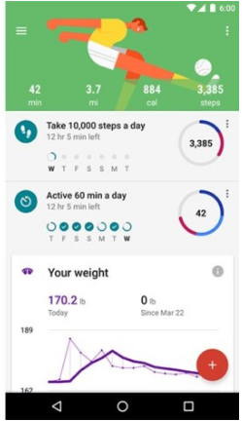
Wearables – fitness trackers
Your data?
Or just use your phone?

Slide 50
Start/run Your own company
Your own online business or community
Facebook Pages and Ads
Blog: Wordpress, Medium, other tools
Skype/Paypal – paid classes

Slide 51
YOUR Smartphone Superpowers
Extend your abilities
Extend your memory
Information at your fingertips
Connect with others – window on other places
https://maremel.com/smart-smartphones

